Slide 1
FindMoto
CEF440
TASK6: DESIGN AND IMPLEMENTATION OF DATABASE
Presented by Group 8

Slide 2
FindMoto
DATABASE
TABLE OF CONTENTS
Type Of Data
Type Of Database/Tool
Database Schema
Database Implementation
Testing And Optimisation

Slide 3
FindMoto
TYPE OF DATA
User Data(Passenger and Driver)
Ride Data
Geographical Location Data
User Authorisation and Authentication
User Feedback and ratings(Driver and Ride)

Slide 4
FindMoto
CHOICE OF DATABASE/TOOL
CHOICE OF NOSQL
Flexible Data Model
Horizontal Scalability
Low latency

Slide 5
FindMoto
DATABASE TOOL
CHOICE OF FIREBASE
Explicit Design
Built in authentication
Real time database

Slide 6
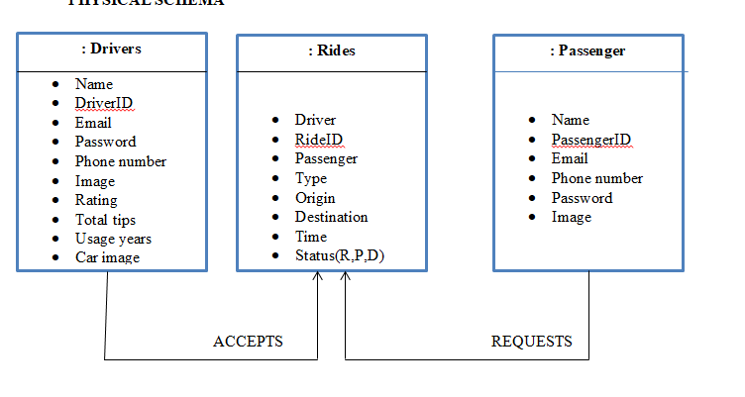
FindMoto
DATABASE SCHEMA
PHYSICAL DATABASE SCHEMA

Slide 7
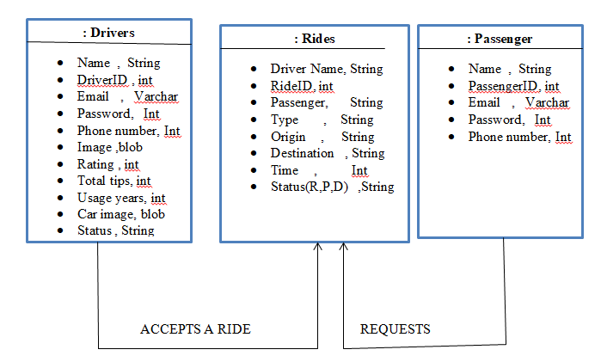
FindMoto
DATABASE SCHEMA
LOGICAL DATABASE SCHEMA

Slide 8
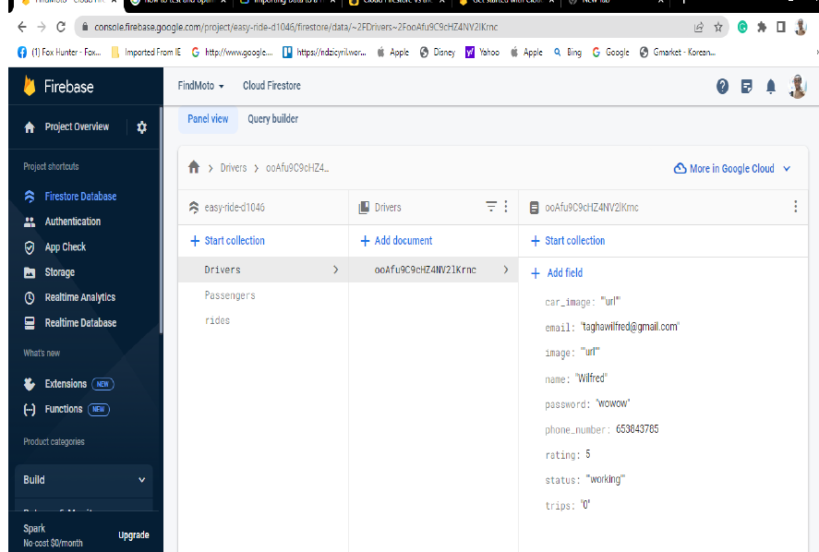
FindMoto
DATABASE IMPLEMENTATION
CREATION OF THE DRIVER’S COLLECTION

Slide 9
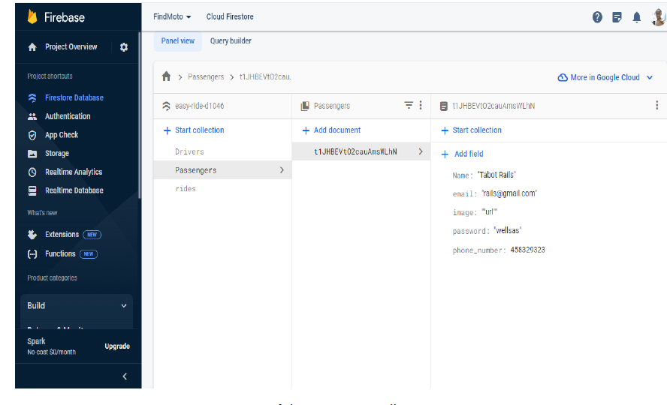
FindMoto
DATABASE IMPLEMENTATION
CREATION OF THE PASSENGER COLLECTION

Slide 10
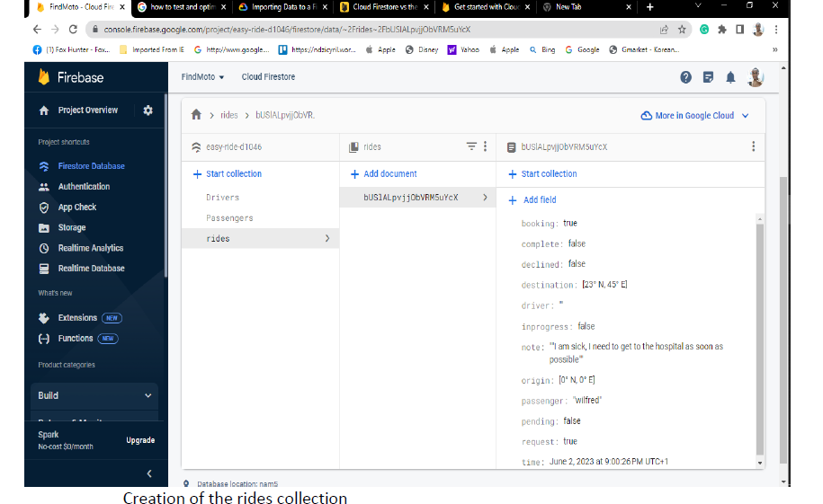
FindMoto
DATABASE IMPLEMENTATION
CREATION OF RIDE COLLECTION

Slide 11
FindMoto
DATABASE OPTIMISATION AND CONCLUSION
TESTING DIFFICULTIES
TESTING SUCCESSES
GENERAL CONCLUSION

Slide 12
TEAM FindMoto
THANKS FOR YOUR KEEN
ATTENTION

